Slide 1
Housing Tutorial
Falcon’s Pointe
https://www.falconspointe.com
912 Klotz Rd, Bowling Green, OH 43402, United States
(419) 353-4316

Slide 2
Falcon’s Pointe Housing
It’s located near Bowling Green State University (walking distance).
Individual leases
Apartments Amenities:
*4 Private/Individual Rooms (incudes: bed, bath, closet and desk)
*equipped kitchen (shared)
*living room (shared)
*inside laundry (shared)
* internet
*others

Slide 3
Falcon’s Pointe Housing
Apartments Complex Amenities
*24/7 computer lab *Clubroom with Billiards
*Wi-Fi *Sand Volleyball Court
*Gym *Basketball Court (Lighted at Night)
*Pool * 24 Hour Emergency Maintenance
*Free shuttle to campus * Others

Slide 4
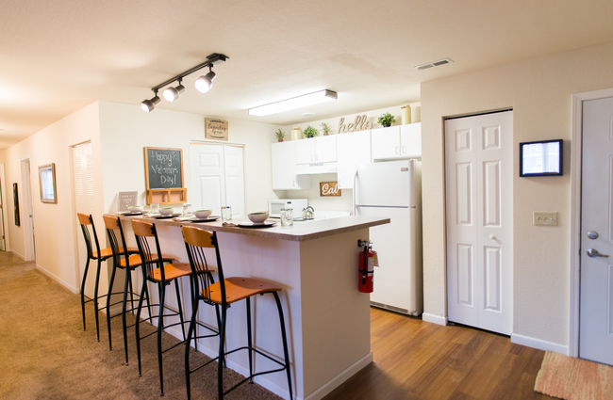
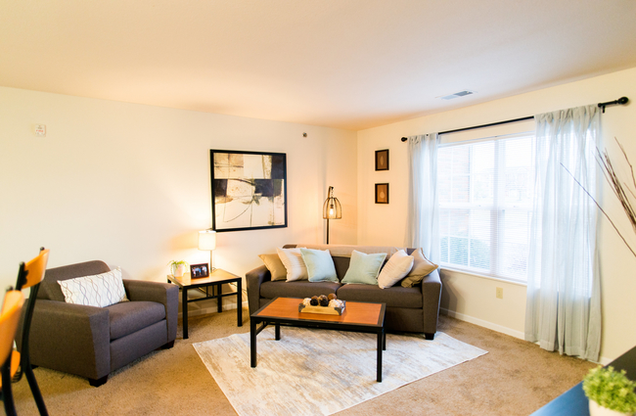
Falcon’s Pointe Facilities

Slide 5
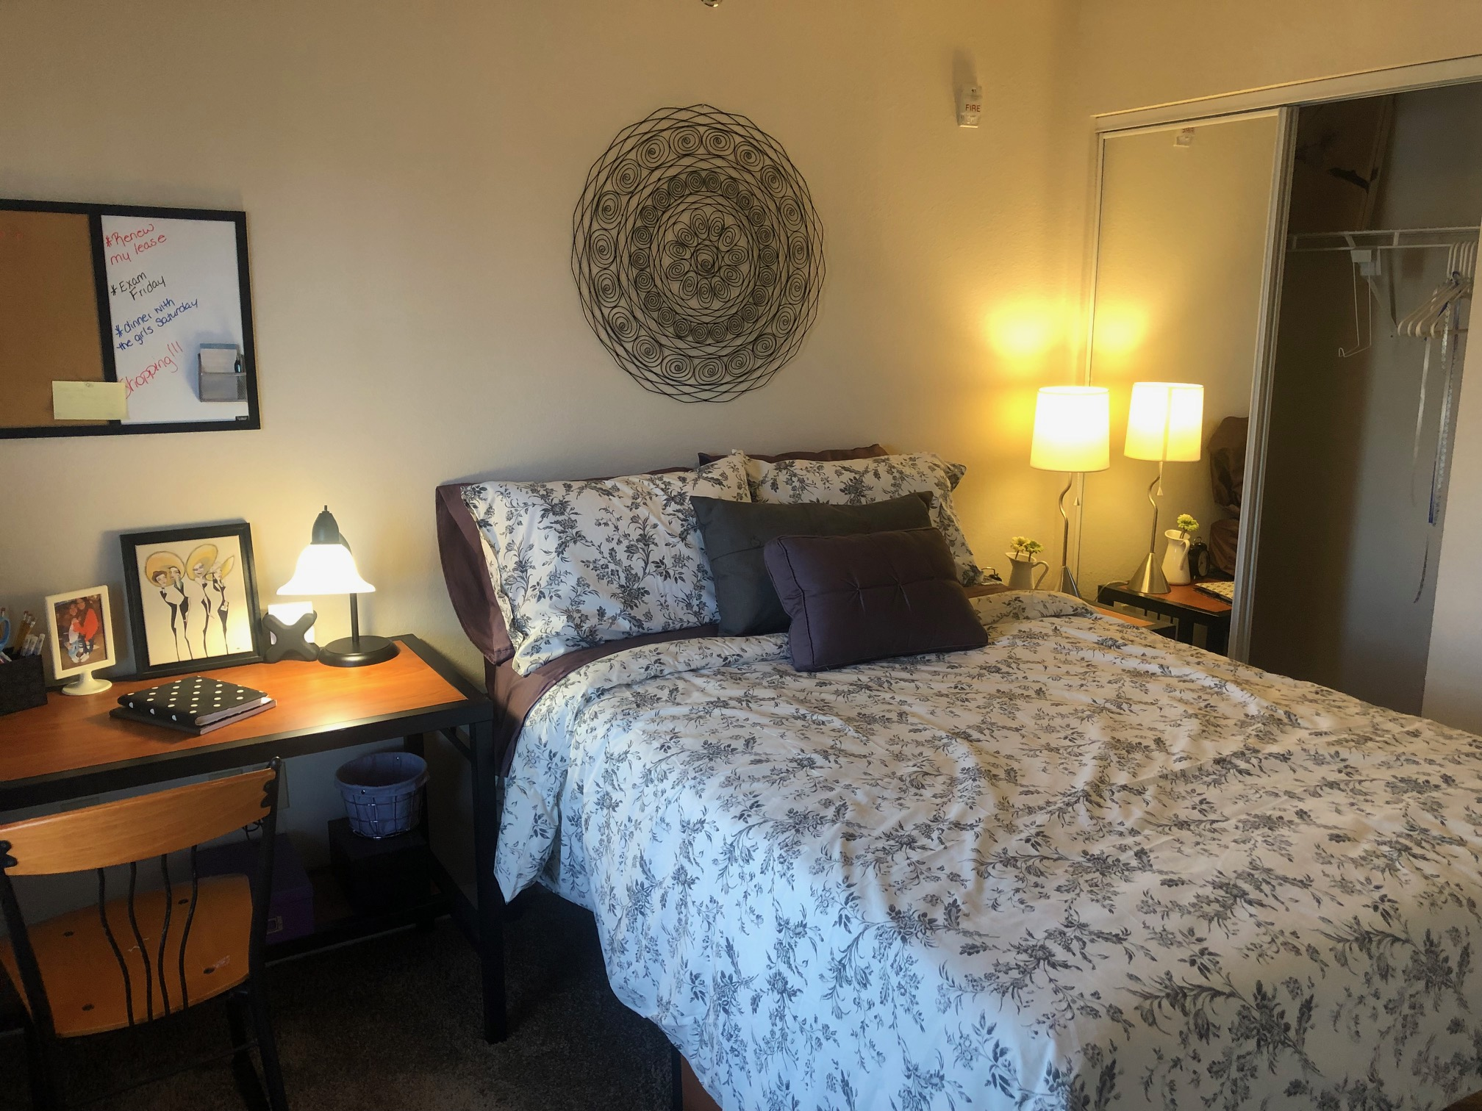
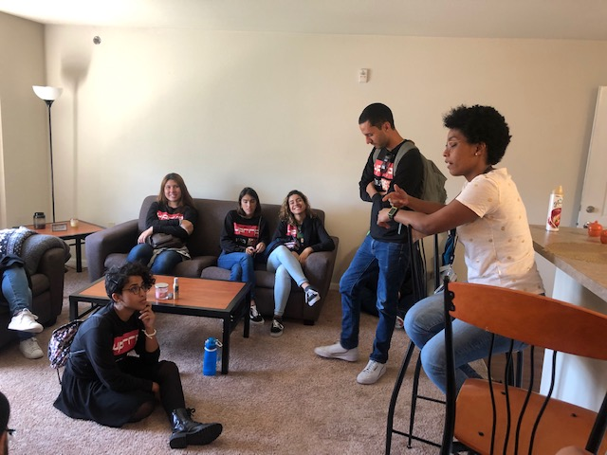
Falcon’s Pointe Facilities

Slide 6
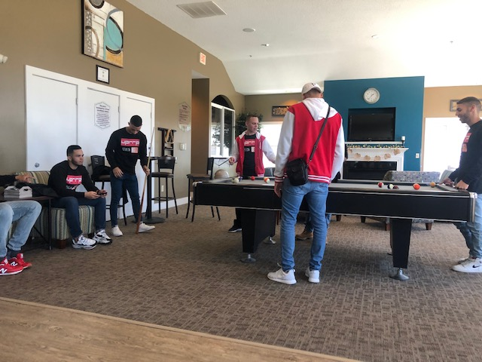
Falcon’s Pointe Facilities

Slide 7
Alternatives to Apply
Contract Renewal
Request a Leasing
You can start living in your apartment since you arrive Bowling Green.
You must wait for the apartment to be delivered (Aug 24, 2020).
Between August 22- 30 you must attend initial orientation.

Slide 8
Contract Renewal Process
You should contact a student who lives in Falcon’s Pointe.
This student must inform Falcon’s Pointe that he wants to renew the contract for the entire year and provide the new student information.
Falcon’s Pointe will contact the new student to start the process.
The costs of renewing the contract are $300 (+ $10 fee if you pay by credit card)

Slide 9
Request a Leasing
You must send an email to Falcon’s Pointe to start the process. leasing1@falconspointe.com
Falcon’s Pointe will send you all the information and the application documents (ask for roommate match).
Leasing Fees
* Security Deposit $100 + Application Fee $35 (+ $10 fee if you pay by credit card).
*Self Guarantor: refundable security deposit ($300) + last month in advance.
*Guarantor: No Leasing Fees.

Slide 10
Lease Rates
10 Months Academic Term $528 (August – May) + electricity and gas costs
12 Months Standard Term $440 (August – August) + electricity and gas costs
( 12 months option is more convenient, because you need to take classes during June)
Note: fees will be charged if you do not pay before moving.

Slide 11
QUESTIONS

