Slide 1
BGSU Admission Process Tutorial

Slide 2
QUESTIONS
Dr. Terence Pitre - tpitre@bgsu.edu
Dr. Aida Lozada - aida.lozada@upr.edu

Slide 3
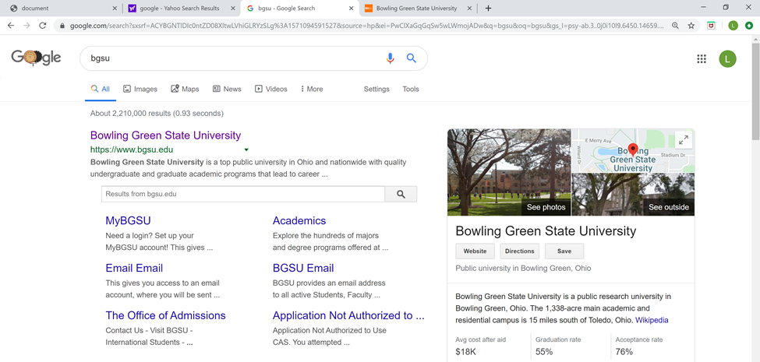
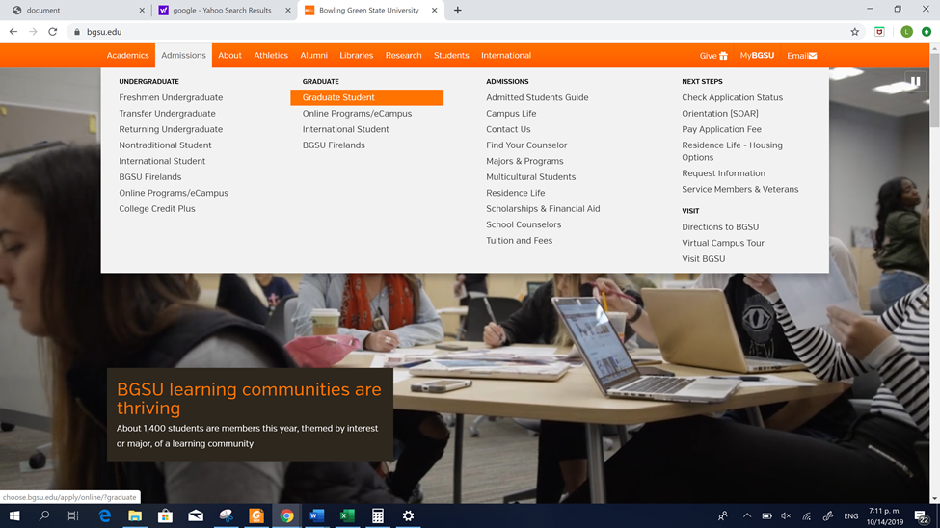
1
Search the official BGSU website
www.bgsu.edu
2
Select “Admissions” and then
“Graduate Student”
https://www.bgsu.edu/business/departments-and-programs/accounting-and-management-information-systems/macc.html

Slide 4
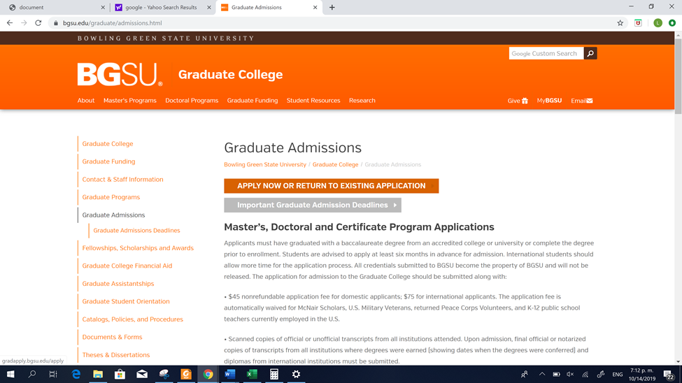
3
Select “Apply now or return to existing Application”

Slide 5
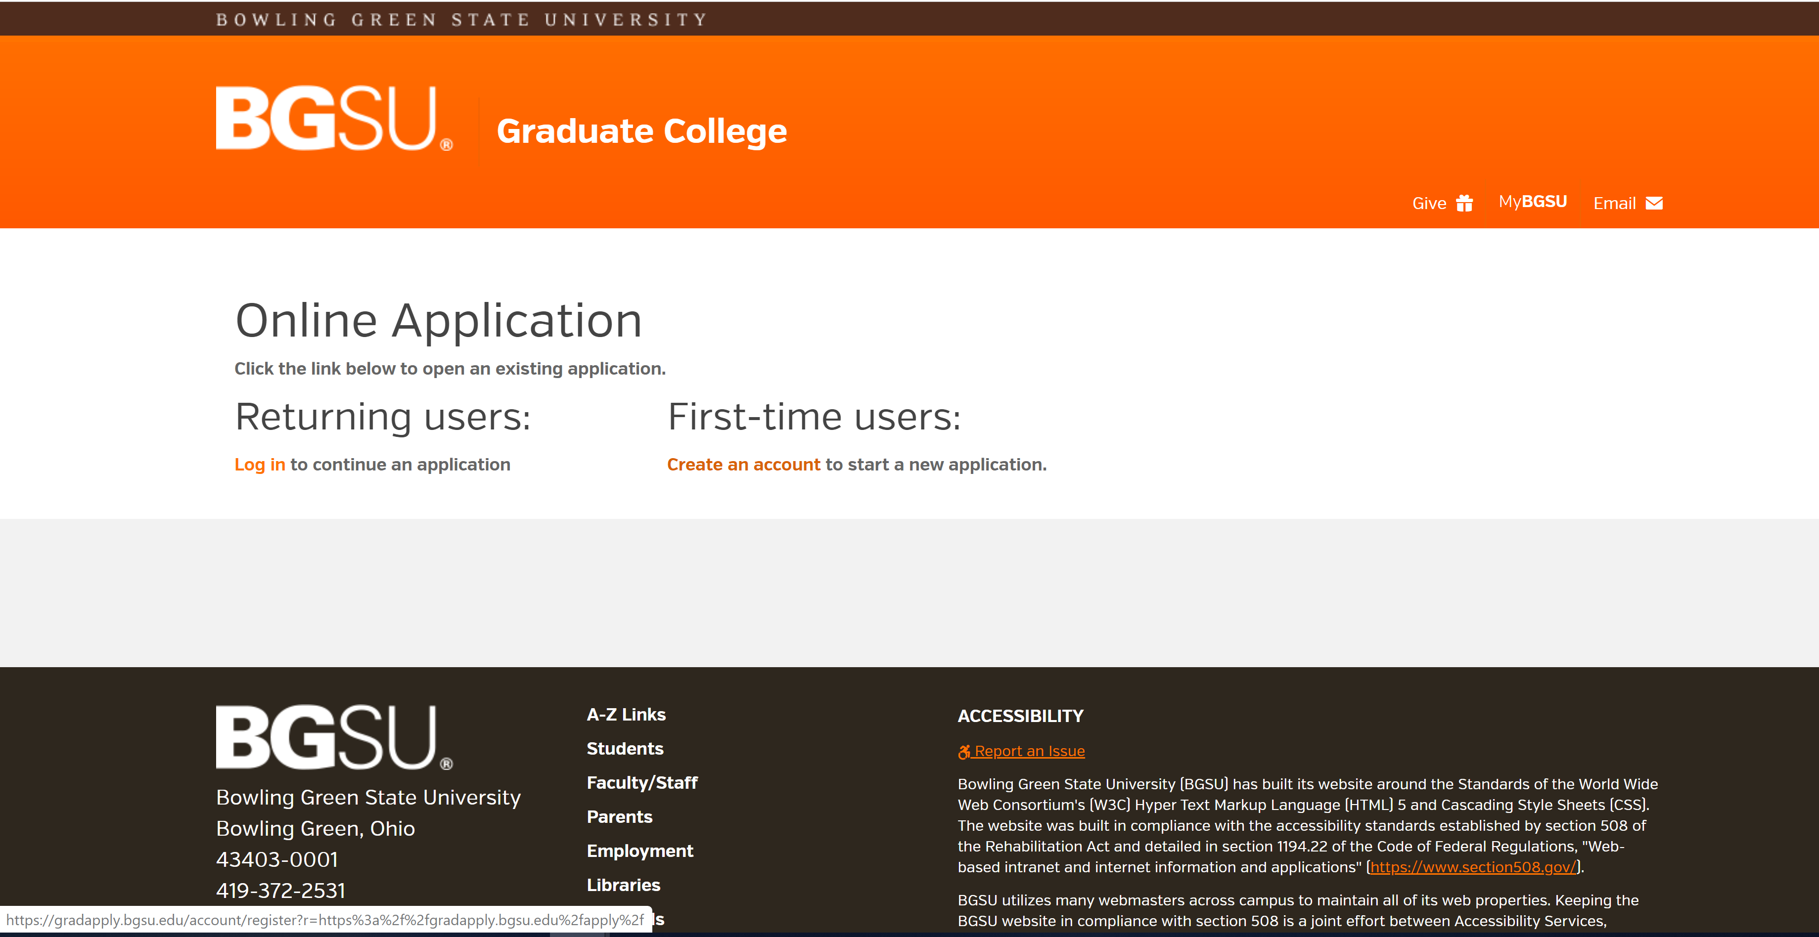
4
The first time you must create an account with your personal information

Slide 6
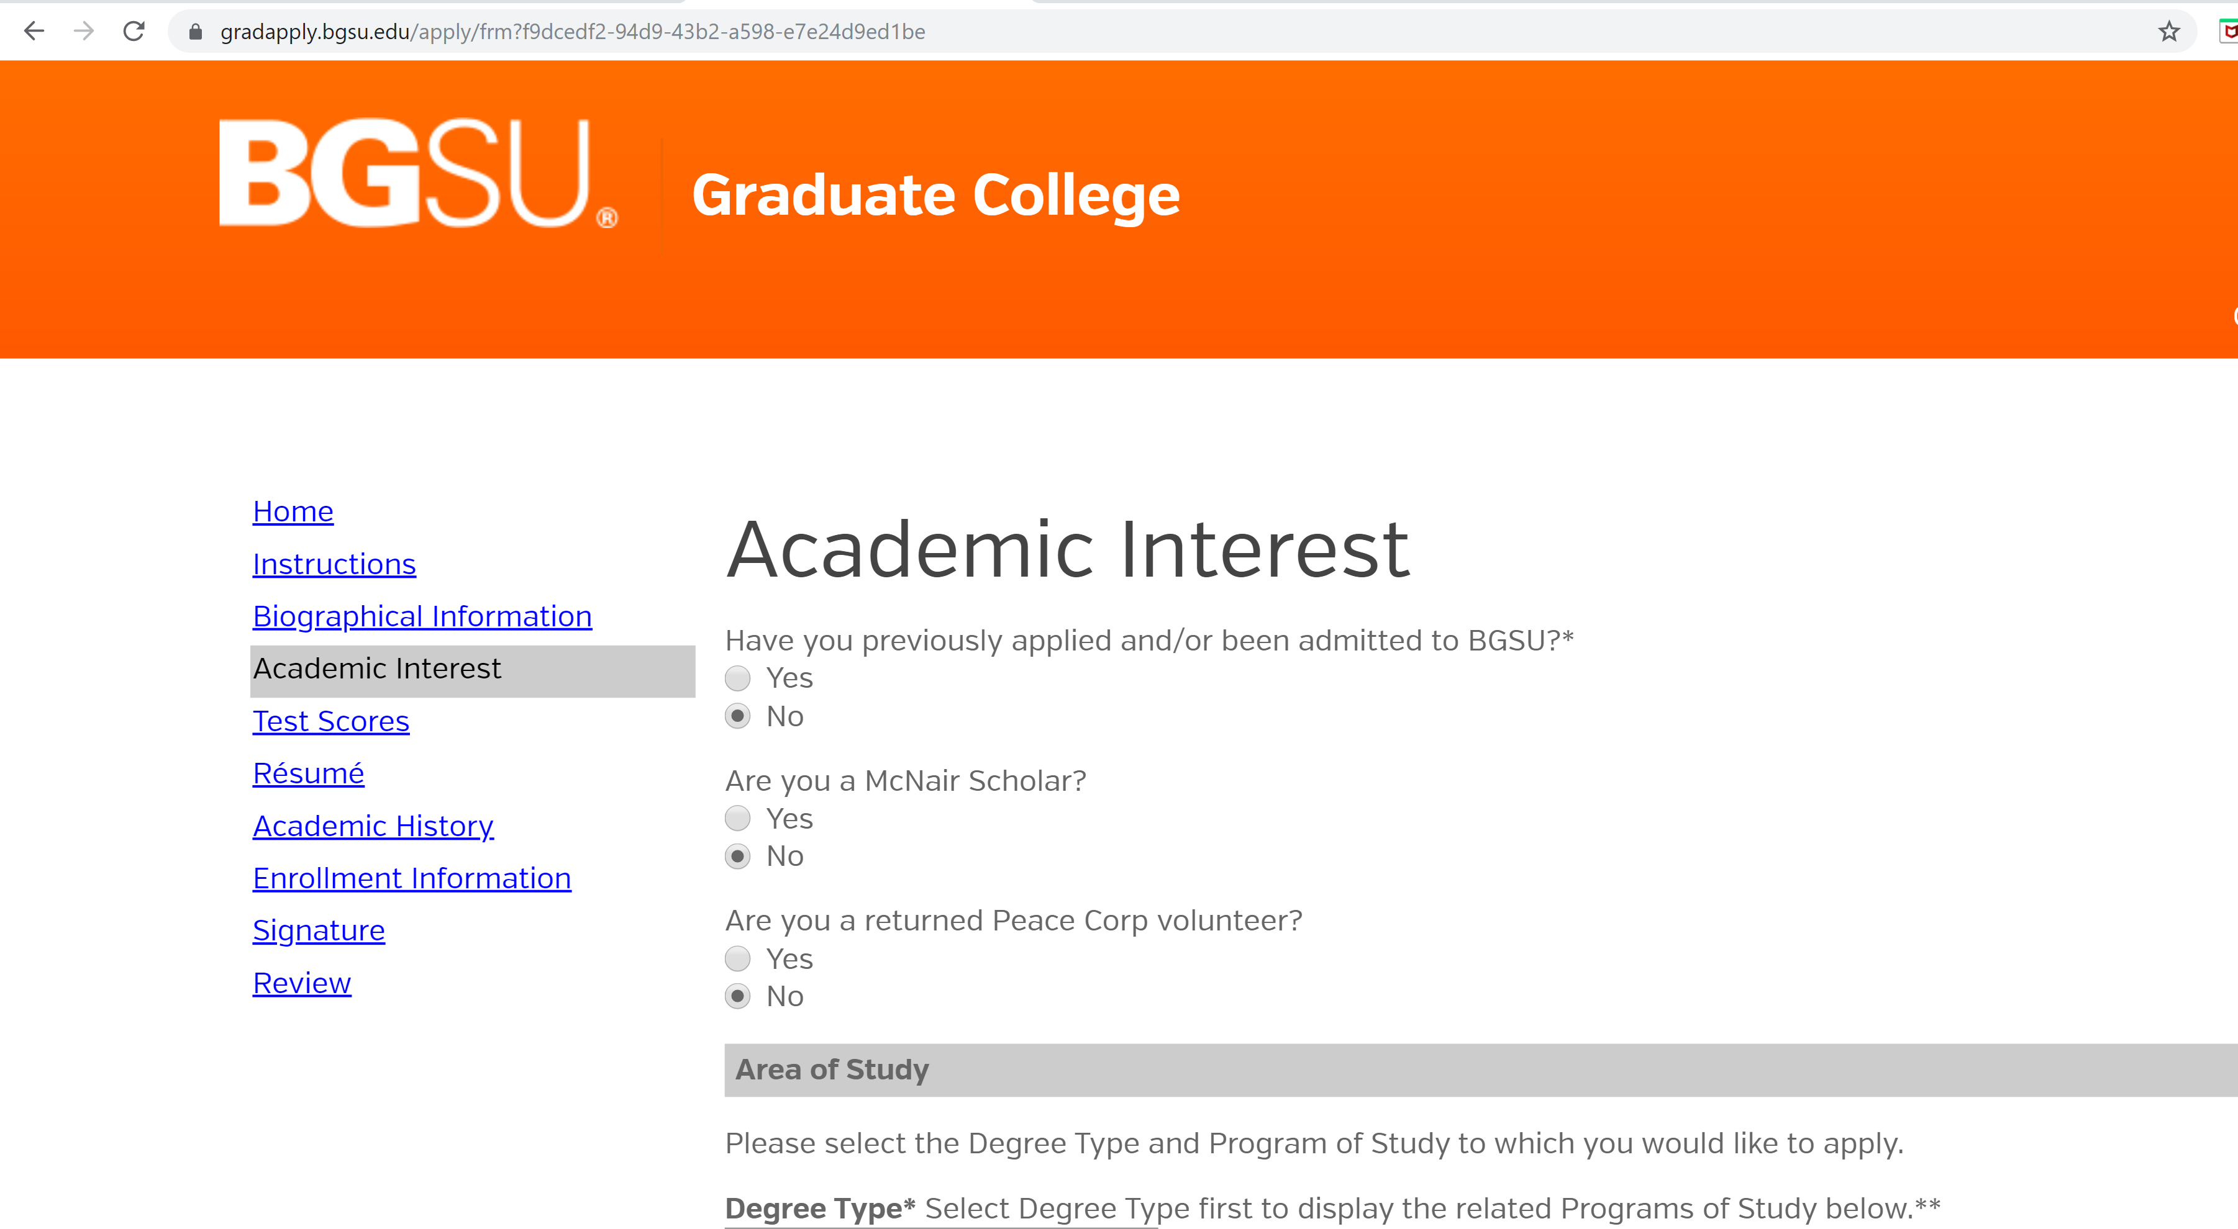
5
Make sure to complete all parts of the application

Slide 7
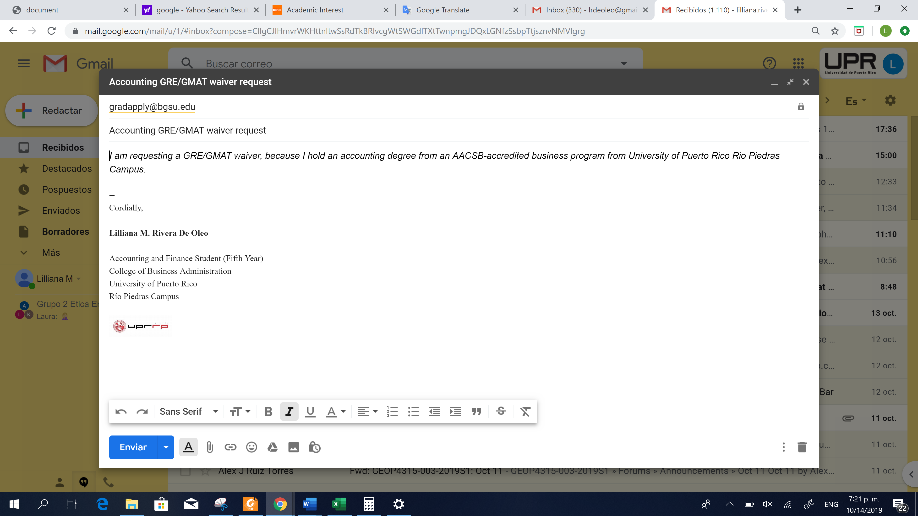
6
REMEMBER
For UPR-RP students
NO GMAT
NO Recommendation Letter
NO Essay
You can request a waiver via email
Here an example

Slide 8
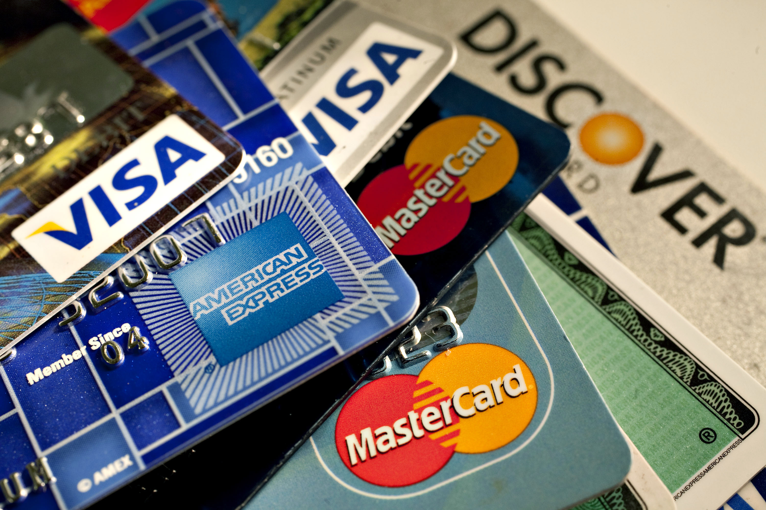
7
Application Fee
The application cost is $ 45, and you can pay it with any credit card or VISA
Save your payment evidence…

Slide 9
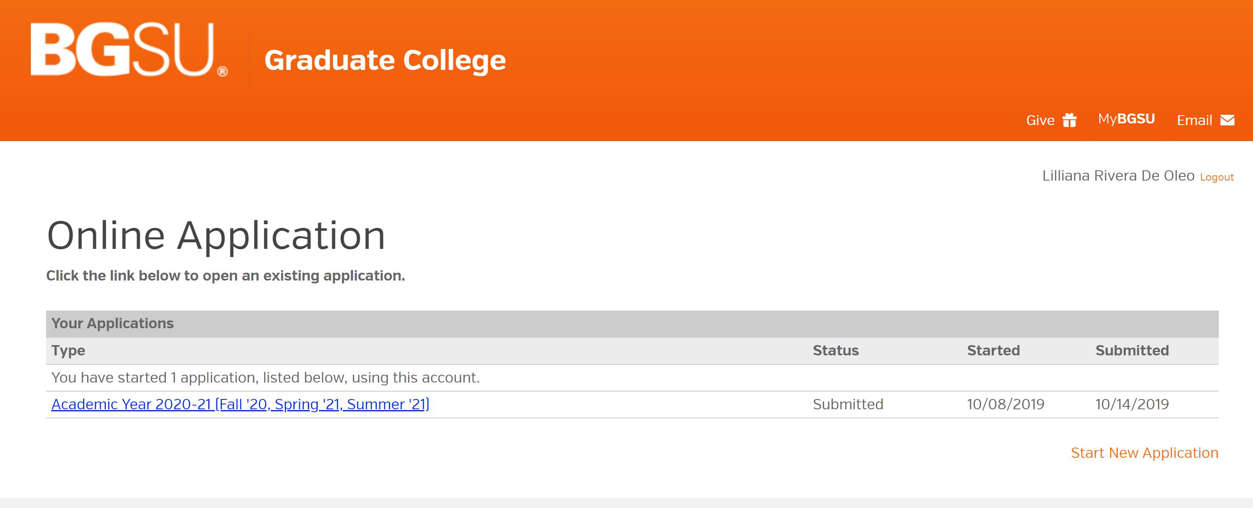
8
After the payment your application will be submitted

Slide 10
QUESTIONS
Dr. Terence Pitre - tpitre@bgsu.edu
Dr. Aida Lozada - aida.lozada@upr.edu

